Slide 1
Good morning my dear students.

Slide 2
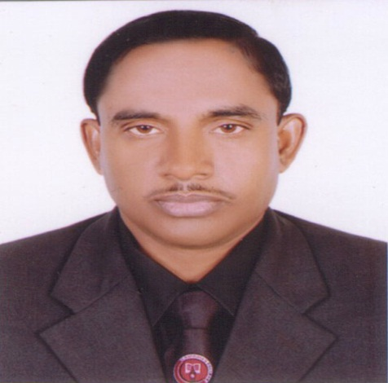
Md Hasan Hafizur Rahman
Senior Lecturer
Department of English
Cambrian School & College,Dhaka,
Class-Nine
English 1st Paper

Slide 3
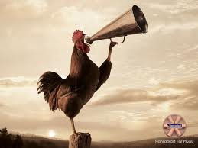
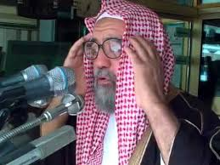
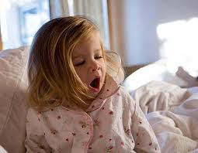
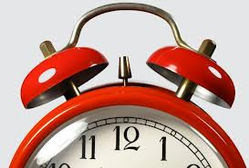
Early Rising

Slide 4
Our Today’s Lesson is-
A paragraph
“Early Rising”

Slide 5
Learning outcomes
After we have studied this lesson we will be able to-
know information
ask and answer questions
have the habit of rising early
write a paragraph.

Slide 6
Now let us know what is early rising?
Early rising is rising
early in the morning.

Slide 7
Who is an early riser?
The man who rises
early is an early riser.

Slide 8
What can he enjoy?
He can enjoy morning prayer, the fresh air, sun rise, natural beauty, birds chirping, can have an opportunity to walk by the river side and can also take some physical exercise.

Slide 9
Why is early rising related to physical exercise?
Early rising is related to physical exercise. Because it is the best time to take physical exercise. Specially walking in the morning is as enjoyable as beneficial.

Slide 10
Why is early rising necessary?
Early rising is necessary to keep our body strong and stable, keep our mind fresh and fair, to maintain discipline of life and our regular activities properly. So we should be to habituated to early rising.

Slide 11
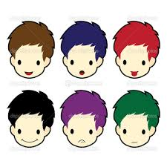
Group Work

Slide 12
Evaluation
Answer the following questions-
What is early rising?
Who is an early riser?
What is the benefit of early rising?
Why should we rise early?

Slide 13
Homework
Write a paragraph on
“Early Rising”

Slide 14
Verse Universal
Early to bed and early to rise makes a man healthy ,wealthy and wise.

Slide 15
Bye bye
যাই যাই

